Slide 1


Dash Training
Ming
1

Slide 2
Table of Contents
1. Brief intro for Python developers
03
2. Frontend basics and Demo 1
07
3. Backend basics and Demo 2
10
4. Setup Swiss Re laptop for development
13
5. Demo of apps and IDEs
16

Slide 3
1. Brief intro for Python developers
1. Brief intro for Python developers
2. Frontend basics and Demo 1
3. Backend basics and Demo 2
4. Setup Swiss Re laptop for development
5. Demo of apps and IDEs

Slide 4
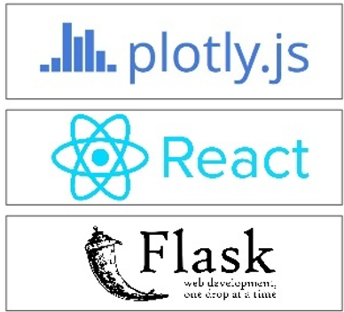
Brief intro
A high “gain/pain ratio” feature for data scientists:
Can be implemented in pure Python
stateless backend / metaprogramming frontend
reactive computation
JSON interface in between
Examples/existing code
Light-weight and agile
“Client-facing” apps
Under the hood
written on top of Flask, Plotly.js and React.js
dash: open-source library, permissive MIT license
For dashboard, analytics, reporting and app
code: https://github.com/plotly/dash-sample-apps
More features and resources can be found at wiki:
https://wiki.swissre.com/display/DSA/Data+science+apps+with+Shiny+and+Dash
Where to get help for Dash? https://community.plotly.com/c/dash

Slide 5
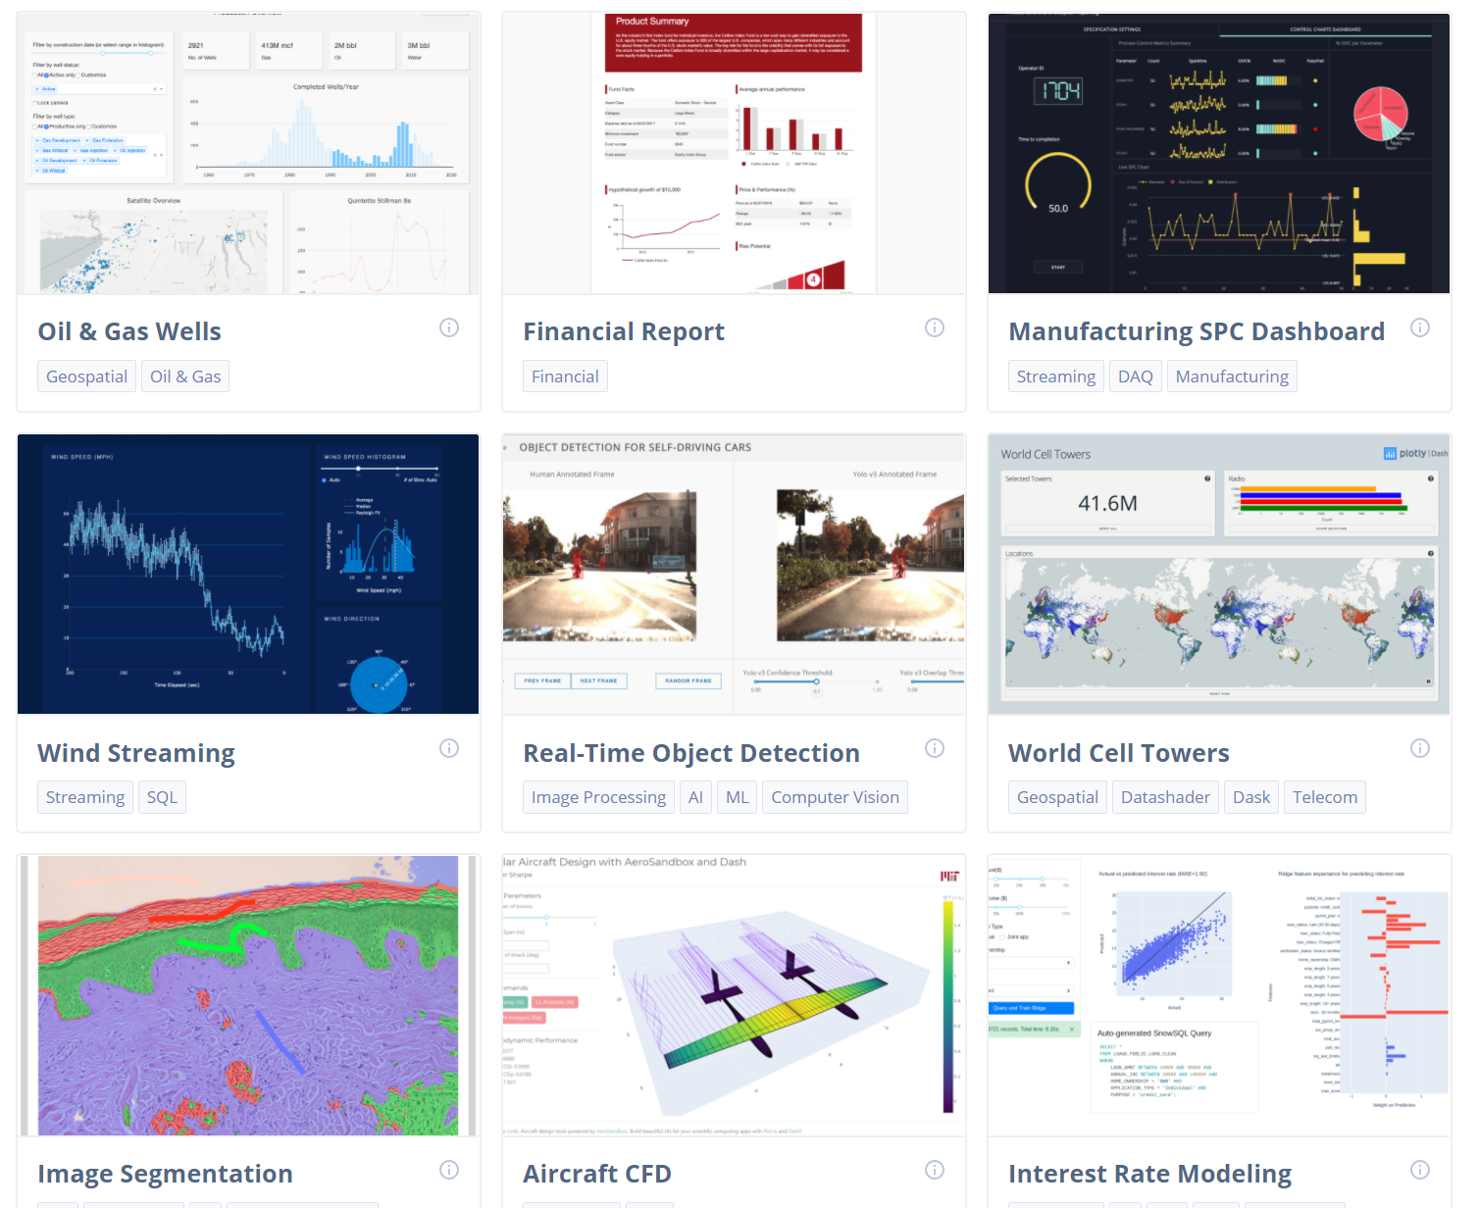
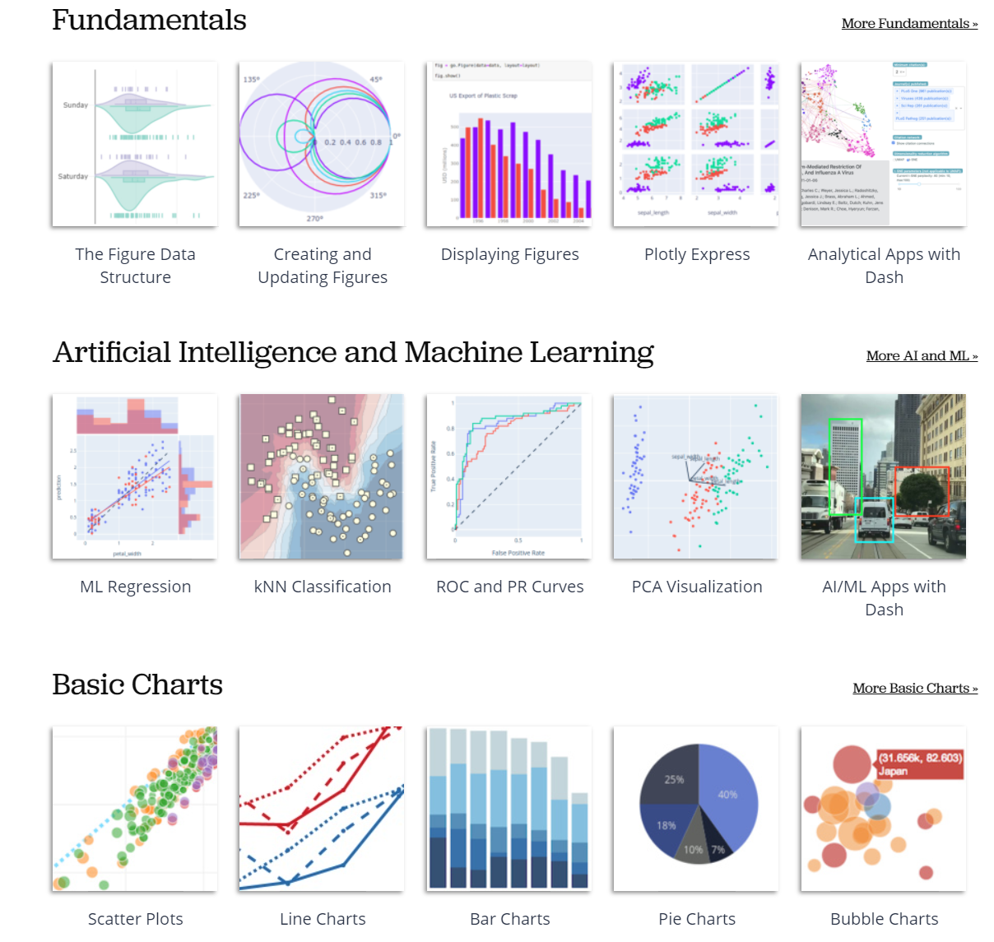
Dash and Plotly Gallery
https://dash-gallery.plotly.host/Portal/
https://plotly.com/python/

Slide 6
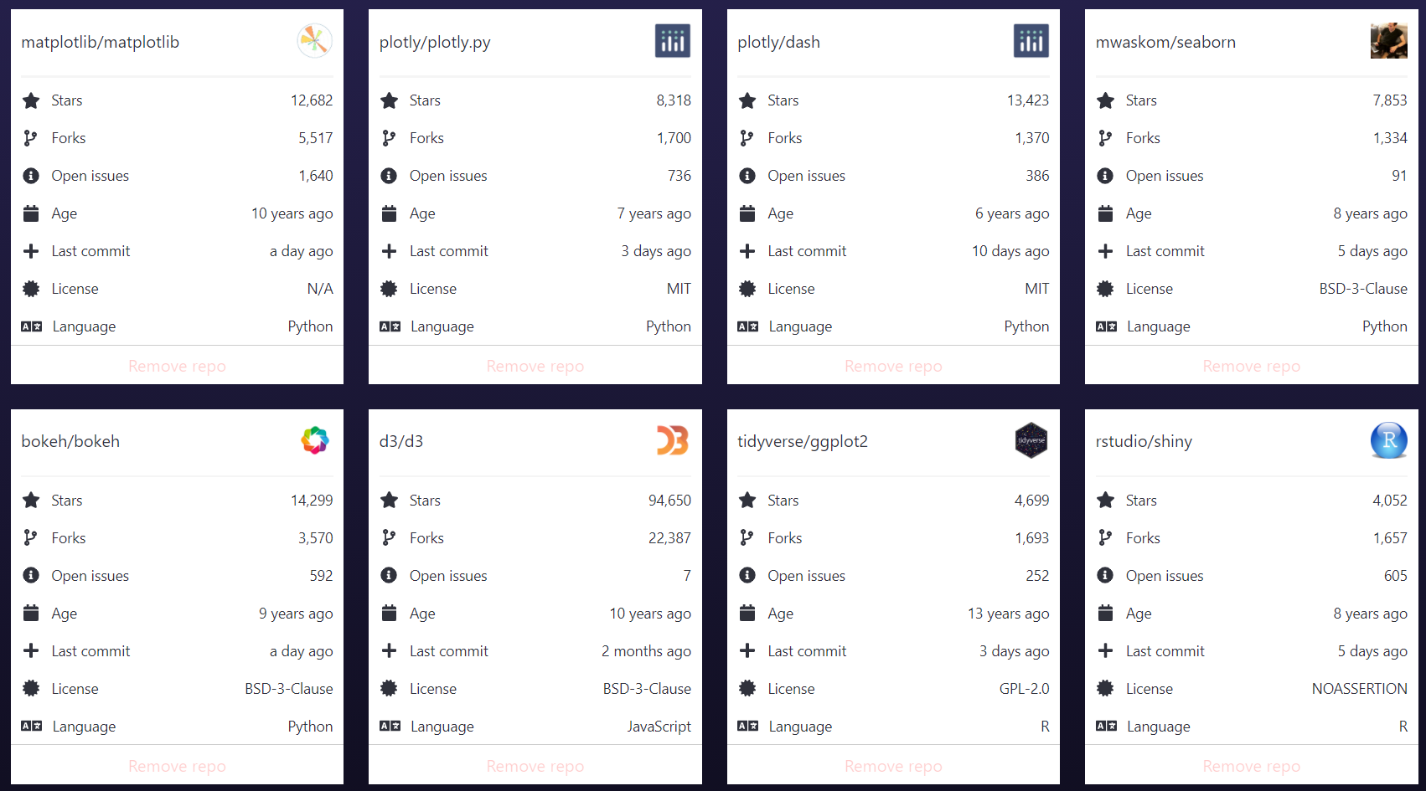
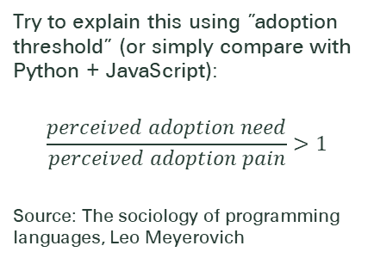
Data Visualization and Dashboard libraries (2020 Nov.)
Dash is the most downloaded, trusted Python framework for building ML & data science web apps.
-- Dash GitHub repo
Try to explain this using ”adoption threshold” (or simply compare with Python + JavaScript):
$$\frac{perceived adoption need}{perceived adoption pain}>1$$
Source: The sociology of programming languages, Leo Meyerovich
Source: https://www.githubcompare.com/

Slide 7
2. Frontend basics and Demo 1
1. Brief intro for Python developers
2. Frontend basics and Demo 1
3. Backend basics and Demo 2
4. Setup Swiss Re laptop for development
5. Demo of apps and IDEs

Slide 8





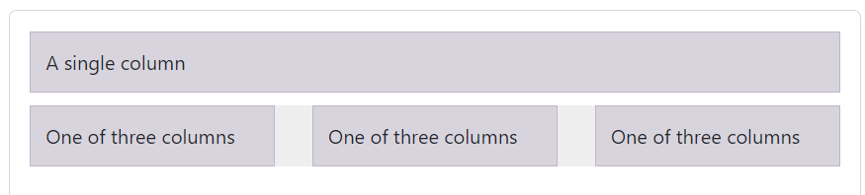

Frontend basics
Very basic components
component class for every HTML tag implemented
Python code to generate a “hello word” heading
More components
dash_core_components(dcc) supercharged core components: Dropdown, Slider, Input Text, Button…
dash_table for interactive data tables in Dash
dash_bootstrap_components(dbc) for Bootstrap
dash_admin_components(dac) for AdminLTE dashboard templates
Whole layout is just a tree of components
html.A()
html.Div()
html.H1(), html.H2(), html.H3()
html.P()
dcc.Dropdown()
dcc.Graph()
dash_table.DataTable()
dbc.Row(), dbc.Col()
dac.Sidebar()

Slide 9
Demo 1: Hello World
Hello Text
component class for every HTML tag implemented in import dash_html_components as html
Python code to generate a “Hello Text!” heading:
Hello Chart
dash_core_components(dcc) supercharged core components: Chart, Slider, Input Text, Button…
Whole layout is just a tree of components
import dash
import dash_html_components as html
app = dash.Dash()
app.layout = html.H1('Hello Text!')
if __name__ == '__main__':
app.run_server()
import dash_core_components as dcc
import plotly.graph_objs as go
app.layout = html.Div(children=[
html.H1('Hello Graph', style={'text-align': 'center'}),
dcc.Graph(
id='my-first-graph',
figure=dict(data=[dict(x=[0, 1, 2], y=[3, 4, 2])])
)
])

Slide 10
3. Backend basics and Demo 2
1. Brief intro for Python developers
2. Frontend basics and Demo 1
3. Backend basics and Demo 2
4. Setup Swiss Re laptop for development
5. Demo of apps and IDEs

Slide 11
Backend basics
Interactivity
Inputs and outputs are described in @app.callback decorator
Input are simply the properties of “components”
Any Output can have multiple Input components
State allows passing extra values without firing callbacks
How does it work
declare app layout with a tree of “components”
frontend sends request when input is changed
backend recalculates the graph of dependencies and send back to frontend

Slide 12
Demo 2: Dash Callbacks
import dash
import dash_core_components as dcc
import dash_html_components as html
from dash.dependencies import Input, Output, State
app = dash.Dash()
app.layout = html.Div([
html.H5("Change the text to see callbacks in action!"),
html.Div(["Input: ", dcc.Input(id='my-input', value='AACoE', type='text')]),
html.Br(), html.Div(id='my-output'),
])
@app.callback(
Output(component_id='my-output', component_property='children'),
Input(component_id='my-input', component_property='value'),
)
def update_output_div(input_value):
return f'Output: {input_value}'
if __name__ == '__main__':
app.run_server()
Exercise: can you paste another string?
Notes:
import dash
import dash_core_components as dcc
import dash_html_components as html
from dash.dependencies import Input, Output, State
app = dash.Dash()
app.layout = html.Div([
html.H5("Change the text to see callbacks in action!"),
html.Div(["Input: ", dcc.Input(id='my-input', value='AACoE', type='text')]),
html.Div(["Input: ", dcc.Input(id='my-input2', value='Cool', type='text')]),
html.Br(), html.Div(id='my-output'),
])
@app.callback(
Output(component_id='my-output', component_property='children'),
Input(component_id='my-input', component_property='value'),
State(component_id='my-input2', component_property='value'),
)
def update_output_div(input_value, input_value2):
return f'Output: {input_value.strip()} is {input_value2.strip()}'
if __name__ == '__main__':
app.run_server()

Slide 13
Demo 2c: Clientside Callbacks (in JavaScript)
import dash
import dash_core_components as dcc
import dash_html_components as html
from dash.dependencies import Input, Output, State
app = dash.Dash()
app.layout = html.Div([
html.H5("Change the text to see callbacks in action!"),
html.Div(["Input: ", dcc.Input(id='my-input', value='AACoE', type='text')]),
html.Div(["Input2: ", dcc.Input(id='my-input2', value='Cool', type='text')]),
html.Br(), html.Div(id='my-output'),
])
app.clientside_callback(
"""
function(input_value, input_value2) {
return input_value + ' is ' + input_value2;
}
""",
Output(component_id='my-output', component_property='children'),
Input(component_id='my-input', component_property='value'),
State(component_id='my-input2', component_property='value'),
)
if __name__ == '__main__':
app.run_server()

Slide 14
Frontend / Backend summary
You can get callbacks from
Button clicks, text(Div/P) clicks
Dropdown list value entered/changed
Graph hover/click on Value
Table clicks, cell text changes
Period timers, URL address change,…
From Dash Callbacks, you can
Update input values
Generate new HTML elements
Update the CSS style of the layout HTML elements
Generate any kind of plot.ly graph
Known Limitations
Two Callbacks can’t share one Output
Workaround: Re-organise the user logic
Can’t call a Callback inside a Callback
Workaround: using Clientside Callbacks
Slow execution for large data
fine tune Python code, Flask-Caching, DB backend
Integrate JavaScript libraries
Write a dash-compatible component

Slide 15
4. Setup Swiss Re laptop for development
1. Brief intro for Python developers
2. Frontend basics and Demo 1
3. Backend basics and Demo 2
4. Setup Swiss Re laptop for development
5. Demo of apps and IDEs

Slide 16
Setup Swiss Re laptop for Python
Order Anaconda or Python at ContactOne
Create an environment for Dash, run
If conda doesn’t work, check config file: C:\Users\<user id>\.condarc
$ conda create --name dash37 python=3.7
$ conda activate dash37
$ pip install dash dash-html-components dash-table
channels:
- defaults
# Specify SSL certificate file
ssl_verify: C:/ProgramData/Anaconda3-2020.02/cacert.pem
# Use proxy servers
proxy_servers:
http: http://gate-zrh.swissre.com:8080
https: https://gate-zrh.swissre.com:9443
# Show channel URLs when displaying
# what is going to be downloaded
# and in 'conda list'. The default is False.
show_channel_urls: true
If pip doesn’t work, check pip.ini at: C:\Users\<user id>\AppData\Roaming\pip
[global]
trusted-host = pypi.python.org pypi.org files.pythonhosted.org public.dhe.ibm.com repo.anaconda.com
proxy = https://gate-zrh.swissre.com:9443
cert = C:/ProgramData/Anaconda3-2020.02/cacert.pem
If above can’t fix your Python, please feel free to contact me.

Slide 17
Setup Swiss Re laptop for development
For local Python development, choose one option on your preference:
Option1 – PyCharm Community Edition
Order at ContactOne
Option2 – VSCode
Download and install VSCode from https://code.visualstudio.com/
install the Python Extension
additional instruction on DSA Wiki
Option3 - PyCharm Professional
follow the instruction at DSA Wiki
For local git:
Order “Git including proxy and certificate” at ContactOne
For Bash terminal and Linux Tools:
Git Bash (comes with git)
Windows Terminal
Download and install latest release at https://github.com/microsoft/terminal
Cygwin
Order “Cygwin Basic” at ContactOne
If any of the options doesn’t work, please feel free to contact me.

Slide 18
5. Demo of apps and IDEs
1. Brief intro for Python developers
2. Frontend basics and Demo 1
3. Backend basics and Demo 2
4. Setup Swiss Re laptop for development
5. Demo of apps and IDEs

Slide 19
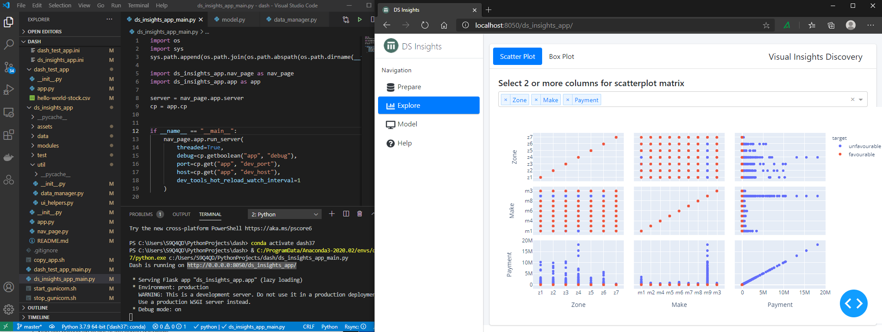
Develop DS Insights app with VSCode

Slide 20
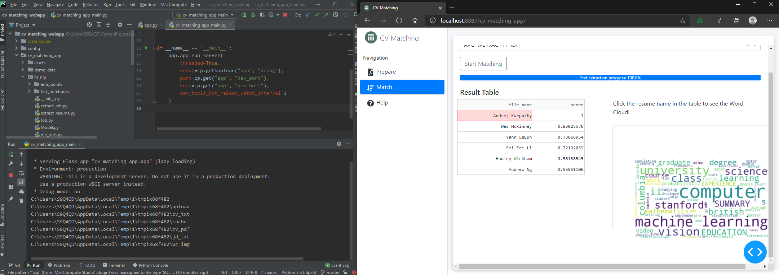
Develop NLP CV matching app with PyCharm

Slide 21





Thank you!
Contact us
Follow us
Ming Li
ming_li@swissre.com
21
21

Slide 23
Legal notice
©2020 Swiss Re. All rights reserved. You may use this presentation for private or internal purposes but note that any copyright or other proprietary notices must not be removed. You are not permitted to create any modifications or derivative works of this presentation, or to use it for commercial or other public purposes, without the prior written permission of Swiss Re.
The information and opinions contained in the presentation are provided as at the date of the presentation and may change. Although the information used was taken from reliable sources, Swiss Re does not accept any responsibility for its accuracy or comprehensiveness or its updating. All liability for the accuracy and completeness of the information or for any damage or loss resulting from its use is expressly excluded.

